Slide 1

String Material Properties’ Effect on Sound
Group 9: Bartosz Brzuchalski, Yilai Chen

Slide 2

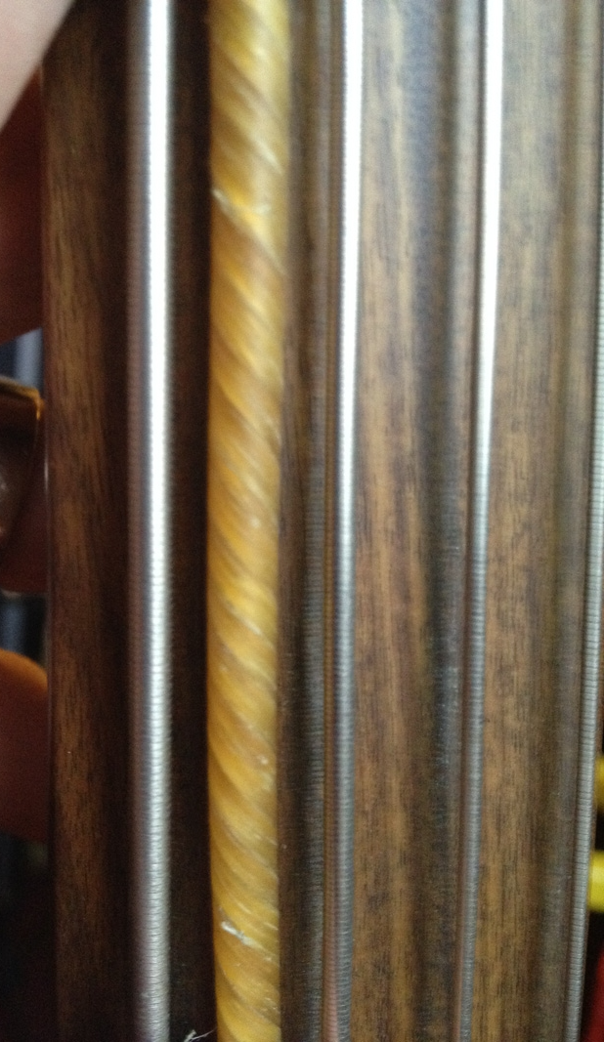
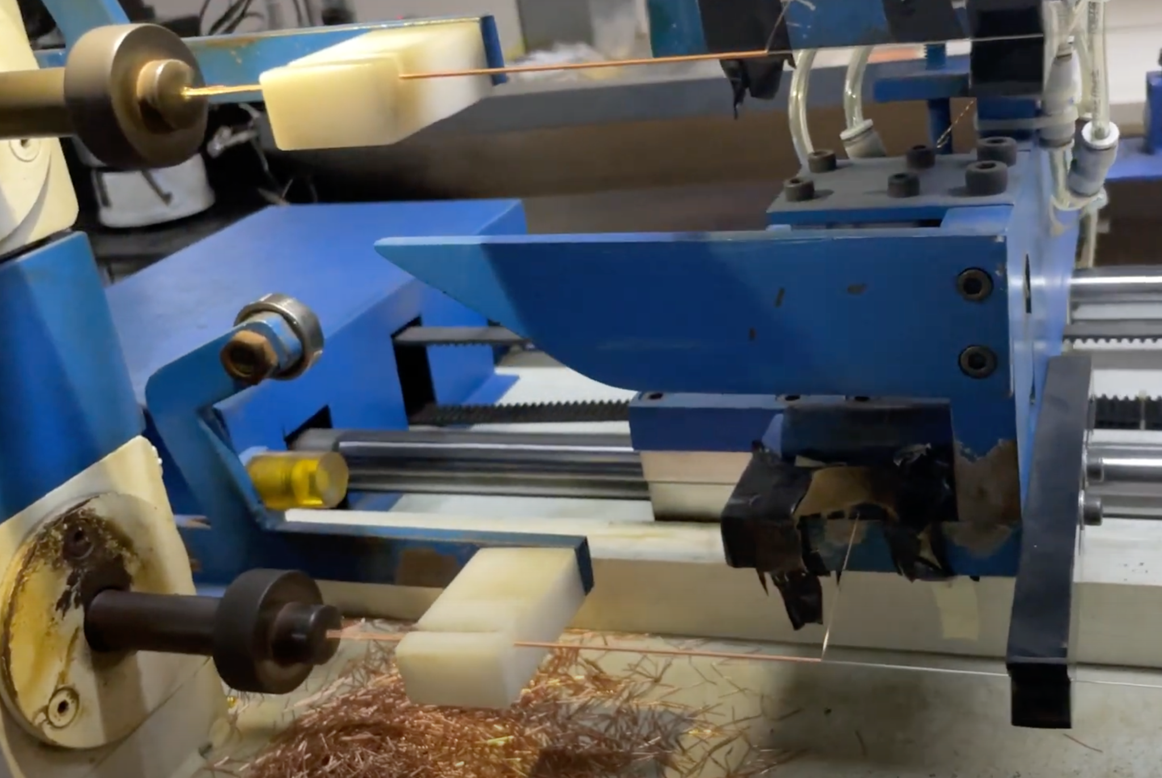
Guitar String History: Gut
Timeline:
1200s: First “guitars” (with gut strings)
1660: Wound strings (Gut strings overwound with metal)
1874: Flatwound strings
Ancient string instruments used gut strings. They could be blended with different materials such as silk or hair.
Overwinding gut strings with metal was discovered to more easily reach lower pitches.
Winding with a flat wire was beneficial for violins because of higher contact area.

Slide 3

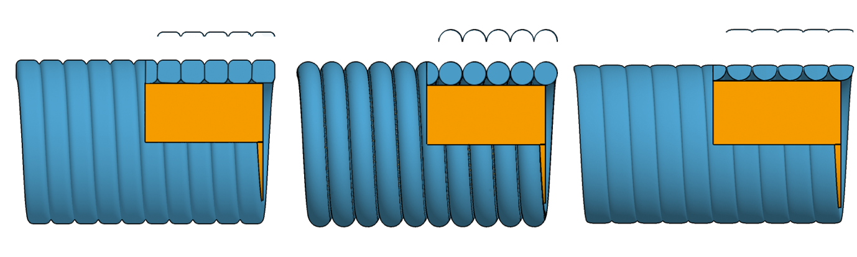
Guitar String History: Steel
Timeline:
1800s: Unison steel strings
1874: Flatwound strings
Late 1800s: Flat-top and Arch-top steel string guitars
1960s: Roundwound guitar strings
As technology progressed, steel strings became cheap to manufacture.
Flat-top and arch-top guitars for steel strings designed by Larson Brothers and Gibson in late 1800s, implementing flatwound steel strings.
Steel-string guitars popularized in mainstream music in 1930s and became electric.
Roundwound strings with more high end to cut through surrounding sound have become the standard.
Flatwound
Roundwound
Half-wound

Slide 4
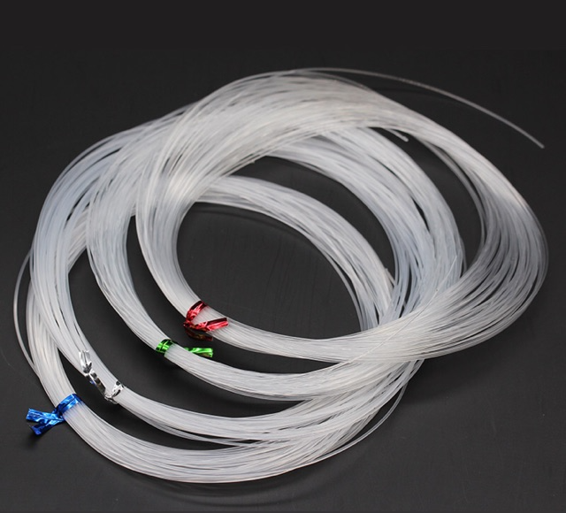
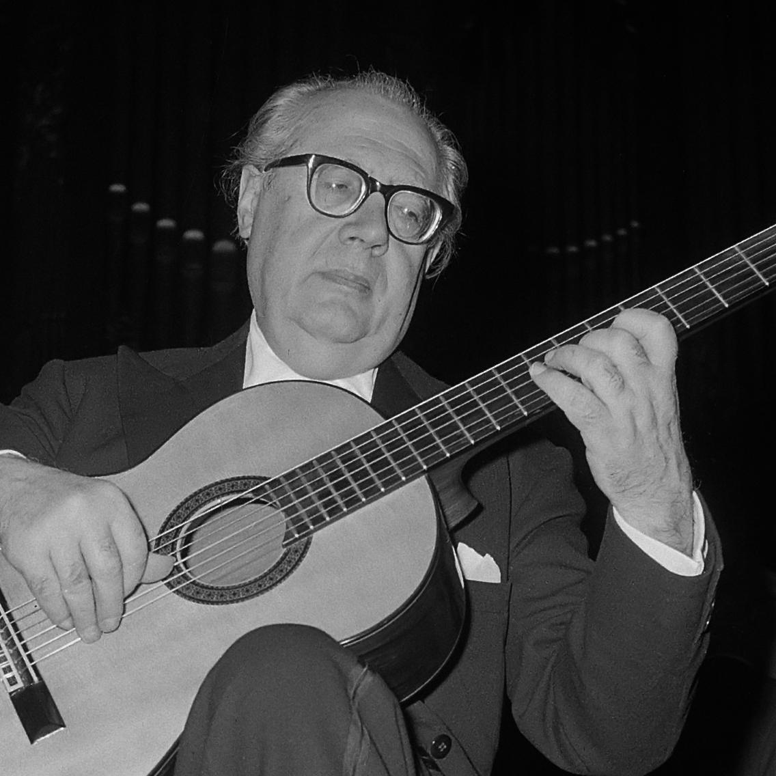
Guitar String History: Nylon
Timeline:
1935: Nylon invented
1948: Commercially manufactured nylon strings
1997: Nylgut (synthetic gut) strings
DuPont invents the synthetic polymer material Nylon in 1935.
During WW2 the military was using gut for surgery which meant a gut shortage for strings.
Classical guitarist André Segovia and instrument maker Albert Augustine developed nylon guitar string to be commercially manufactured (1948).
Nylgut (synthetic material replicating gut) was developed by Aquila in 1997 to better replicate timbre of gut strings than nylon.

Slide 5
The Questions We Want Answered
Do flatwound strings sound more like gut/silk strings than roundwound strings do?
From a physics standpoint, what characterizes the sounds of different string materials?

Slide 6
Method: Laboratory Setup & Strings Used
Location: Speech, Music, and Hearing Department at KTH
Equipment: Suspension mechanism (same as Guitar Lab), condenser microphone, audio interface, computer (Audacity)
Procedure:
Strings mounted individually and tuned to D2 (wound) or D3 (unison)
Microphone placed ~1.5 cm above string
Plucking performed at 1/8th of string length (65 cm)
Recorded at 44100 Hz sample rate, processed in Logic Pro
Dynamics: mp, mf, f
Unison Strings: Gut, Nylgut, Nylon, Steel
Wound Strings: Silk, Nylgut, Nylon, Roundwound, Flatwound

Slide 7
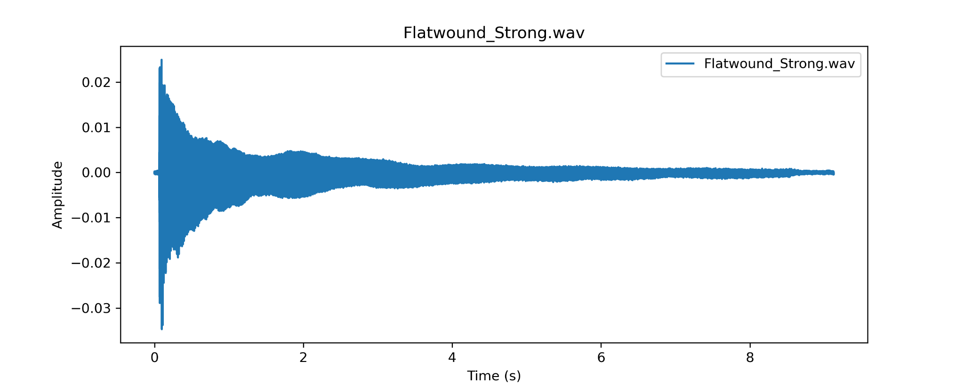
Method: Computer Analysis
Tasks:
Waveform Plotting
Visualizes amplitude variations over time.
Spectral Analysis (Partial Detection)
Apply STFT, detect peaks and display spectrograms
Amplitude Envelope Estimation
Fitted exponential decay models to amplitude data
Inharmonicity Coefficient Calculation
Measured deviation of partials from harmonic frequencies.
Waveform and Frequency Spectrum Envelope Estimation:
Using functions that utilize the Hilbert transform and spline interpolation.

Slide 8
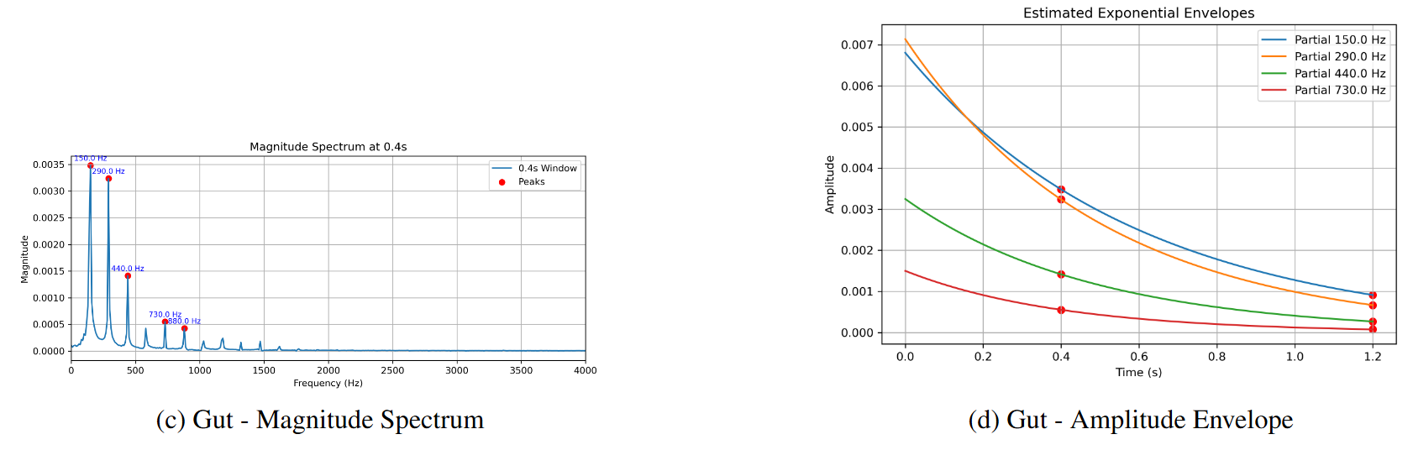
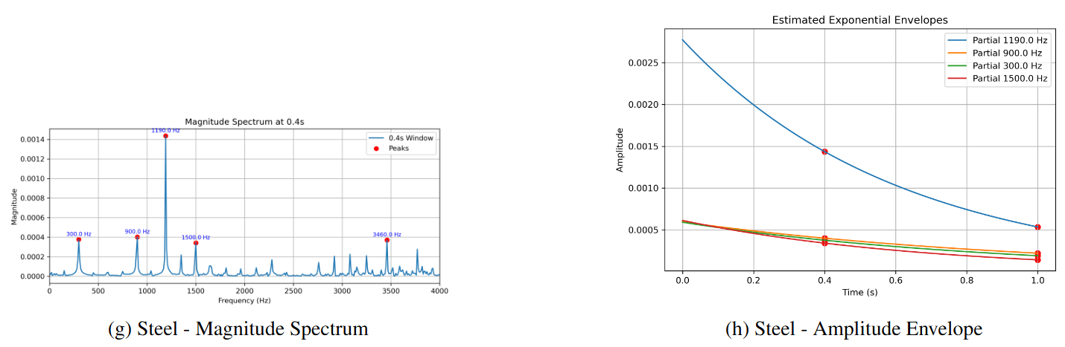
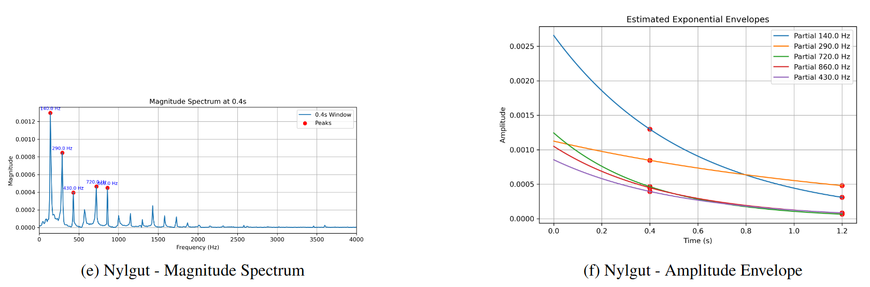
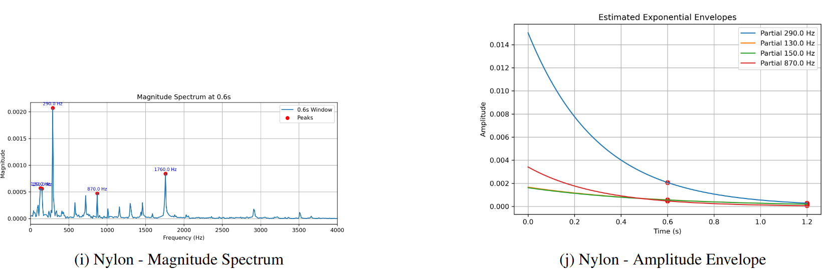
Results: Partial Detection & Amplitude Envelope Estimation
Unison Strings: Gut, Nylgut, Nylon, Steel

Slide 9
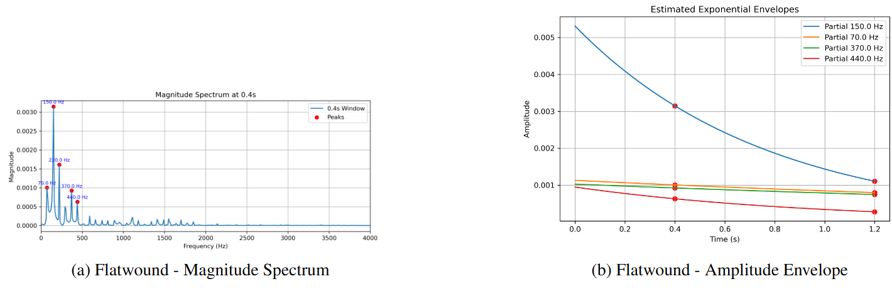
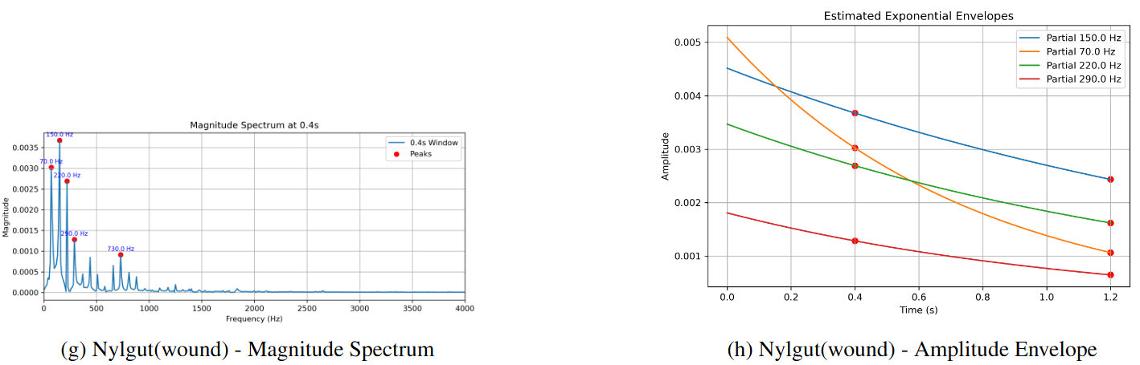
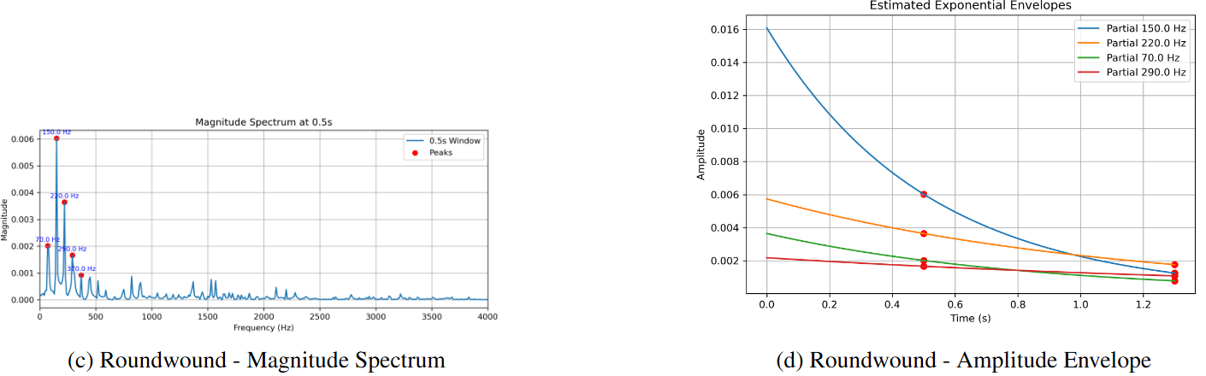
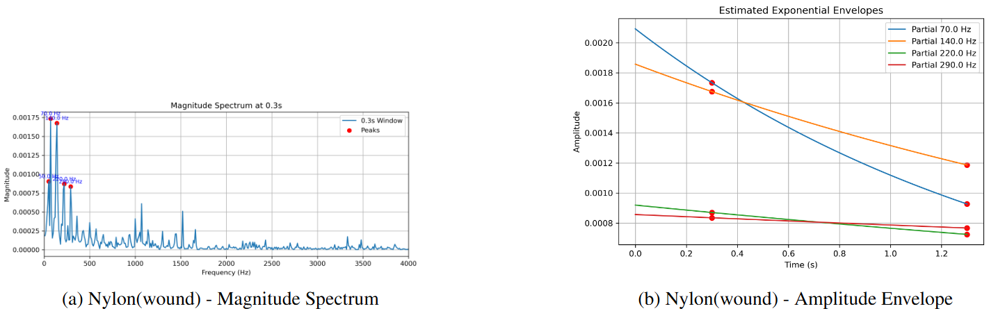
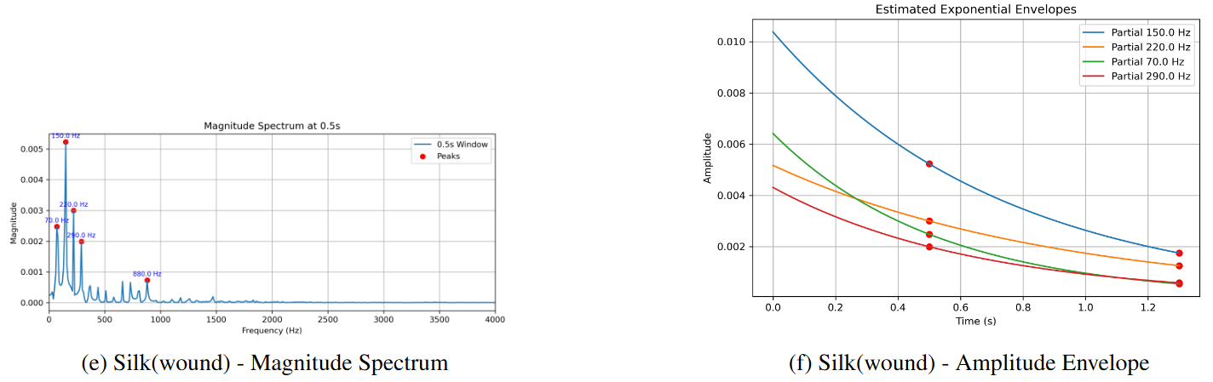
Results: Partial Detection & Amplitude Envelope Estimation
Wound Strings: Silk, Nylgut, Nylon, Roundwound, Flatwound

Slide 10
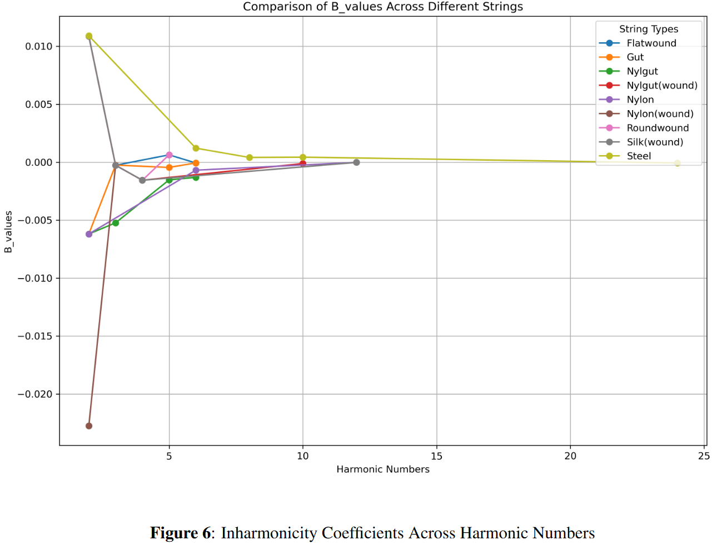
Results: Inharmonicity Coefficient B
Steel strings show the highest initial inharmonicity but stabilize quickly as the harmonic number increases.
Most strings display small variations, generally staying close to zero inharmonicity.
In general, inharmonicity decreases with higher harmonic numbers for all string types.

Slide 11
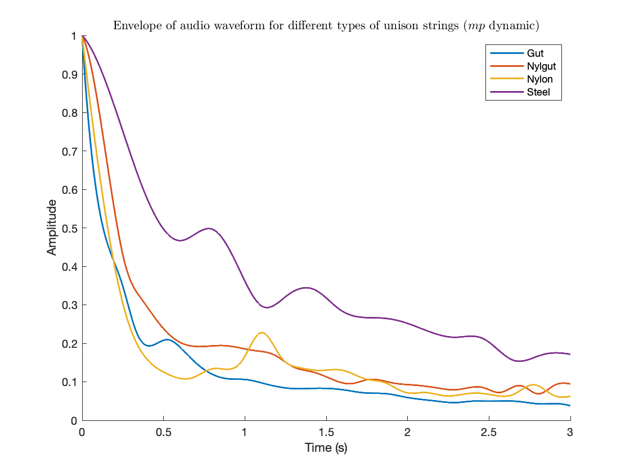
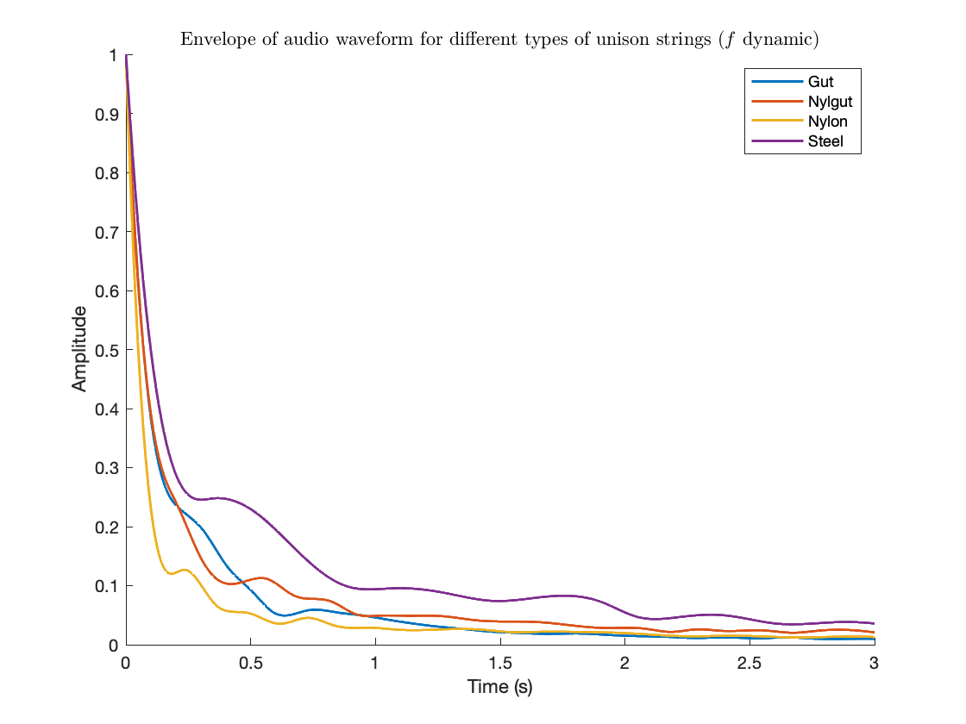
Results: Envelope of the audio waveform (unison strings)
(Soft pluck)
(Strong pluck)

Slide 12
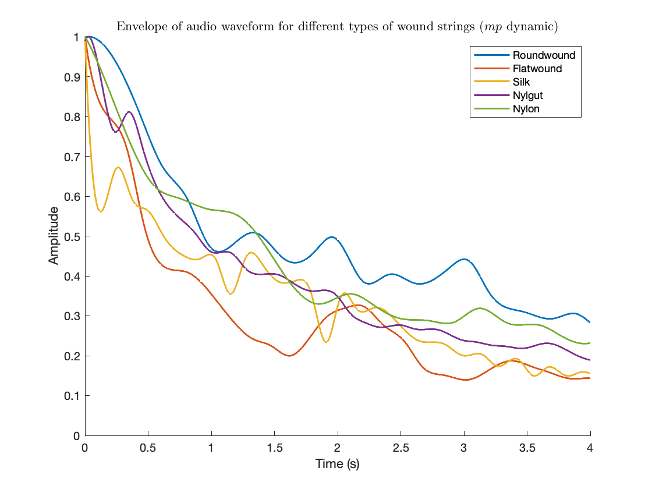
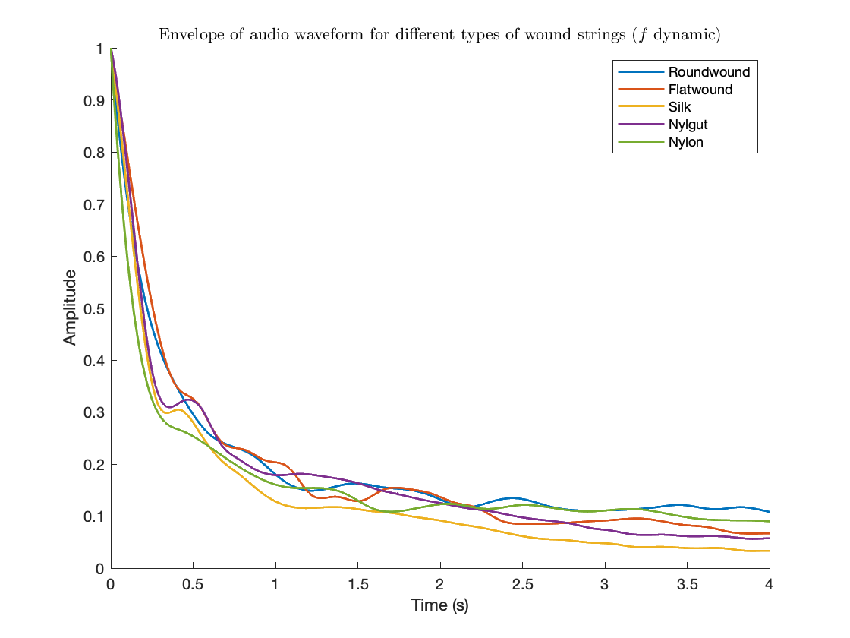
Results: Envelope of the audio waveform (wound strings)
(Soft pluck)
(Strong pluck)

Slide 13
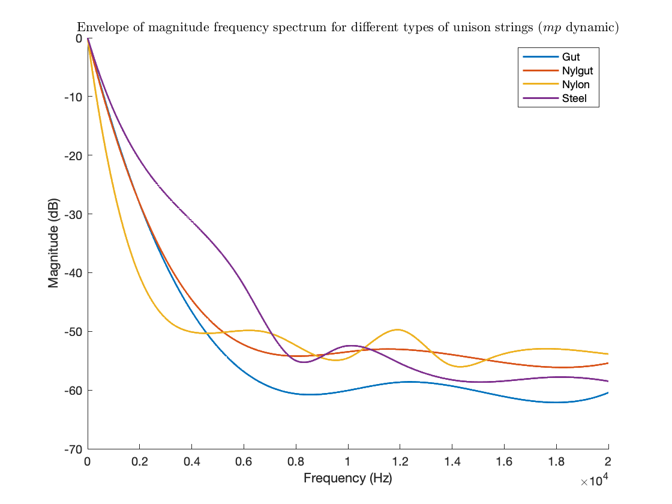
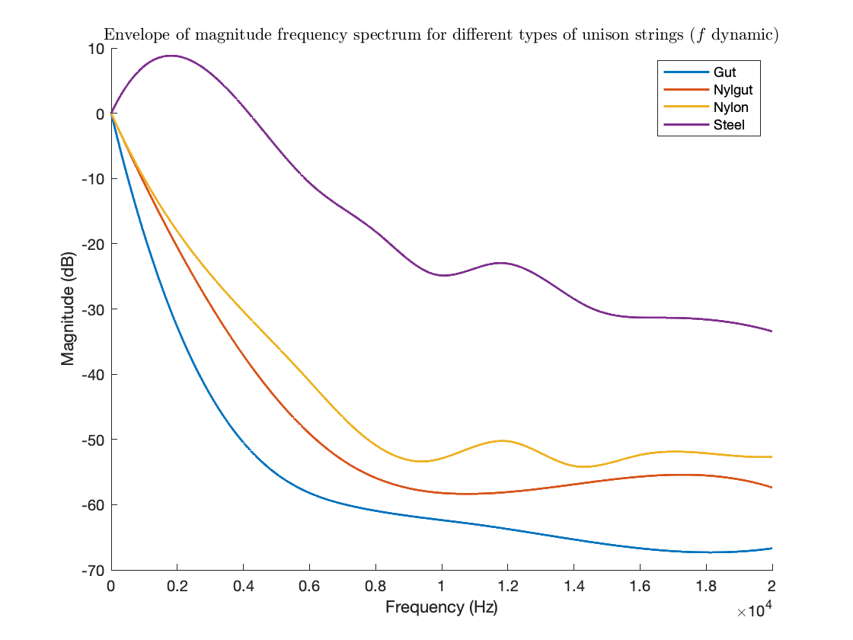
Results: Envelope of the frequency spectrum (unison strings)
(Soft pluck)
(Strong pluck)

Slide 14
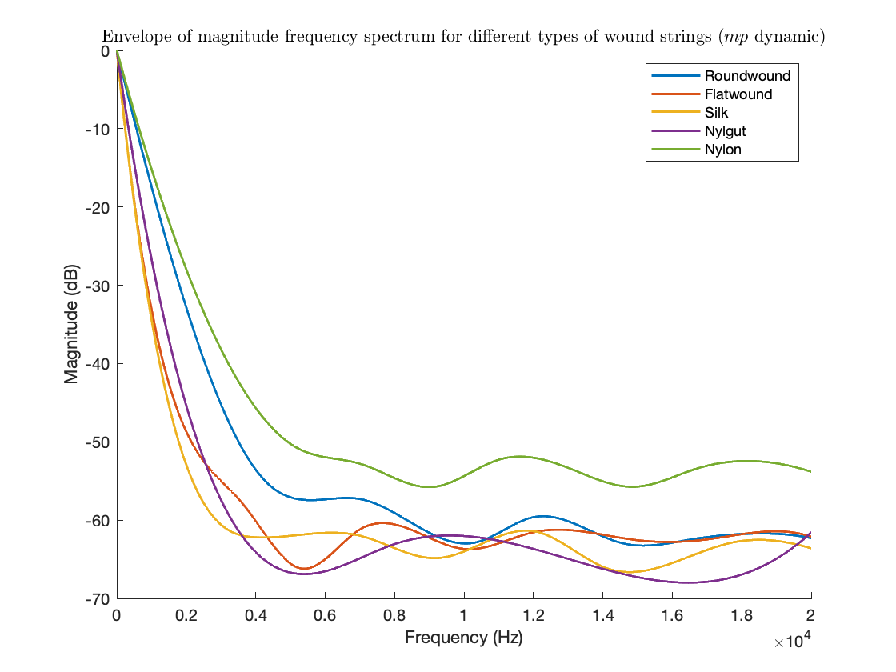
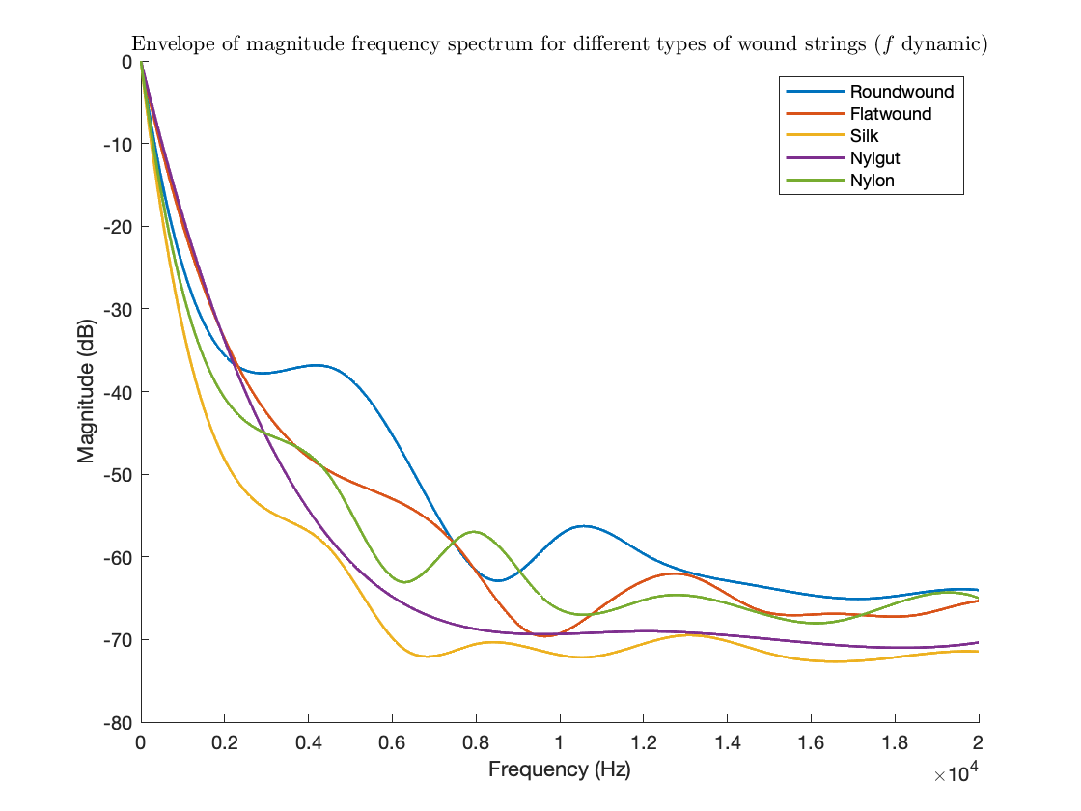
Results: Envelope of the frequency spectrum (wound strings)
(Soft pluck)
(Strong pluck)

Slide 15
Conclusions
Wound vs. Unwound Strings:
The greater vibrating mass of wound strings provides a longer vibration duration, which means their amplitude decay may be slower than that of unwound strings.
Roundwound vs. Flatwound:
The former shows stronger high-frequency content with more pronounced peaks beyond 500 Hz. Indicates a brighter tone with more harmonic richness.
Material Influence:
Steel strings produce the strongest initial peaks with fast decay in higher harmonics, leading to brightness but short sustain in sound quality.
Nylgut(wound) and Silk(wound) show relatively even decay across partials, providing a balanced tonal character.

Slide 16
Conclusions
Conclusions
From Waveform Envelope
Unison:
Steel strings are the big outlier decaying slower than the rest.
Wound:
Flatwound and Silk strings consistently decay slower and Roundwound strings decay faster.
General:
Differences disappear in higher dynamics
From frequency spectrum envelope
Unison:
Consistently in order of higher frequency content: Steel, Nylon, Nylgut, Gut. Differences get higher for higher dynamics.
Wound:
Roundwounds and Nylon generally have more high frequency content than Flatwounds, Silk and Nylgut but trends are harder to identify for higher dynamics.

Slide 17
To Answer Our Questions
Do flatwound strings sound more like gut/silk strings than roundwound strings do?
Somewhat, yes. Flatwounds have more similar decay and high frequency content to gut/silk strings than roundwounds do.
From a physics standpoint, what characterizes the sounds of different string materials?
Different string materials are able to achieve different frequencies when suspended. They also experience different frequency content at these frequencies, emit this content varyingly over time and behave differently at different dynamics.

